Slide 1

AgroTech
Smart Farming,
Better Future
Presented By
Muaaz Bin Mukhtar FA21-BSE-045
Muhammad Moiz FA21-BSE-044
Ammar Ali FA21-BSE-042
Supervised By
Ms. Saira Beg
Notes:
Asslamualikum,
I am Muaaz Bin Mukhtar. With me is Mohammad Ammar Ali and Muhammad Moiz. We have proposed a system "AgroTech" for our final year project under the supervision of Mam Saira Beg.

Slide 2

Introduction
AgroTech is a web-based platform that modernizes agriculture using AI, ML, and image processing. It offers farmers, sellers, and customers tools like crop recommendations and monitoring, soil and climate analysis, and an AI-powered chatbot for support. The platform also features a marketplace to connect farmers with buyers, enhancing market access and profitability. By streamlining the agricultural process—from planting to harvesting to marketing—AgroTech enables data-driven decisions, boosting crop yield and sustainability, while addressing inefficiencies in traditional farming practices.
Notes:
AgroTech is a web-based platform designed to revolutionize the agricultural industry as it is the backbone of our economy. AgroTech will be equipped with the latest technologies such as ML, AI, Image generation. AgroTech aims to provide assistance to users throughout the lifecycle of a crop. That is from recommending a crop to monitoring it. Then from harvesting it to selling it. It also provides data driven insights to users to help make informed decisions ultimately improving crop quality and quantity. The purpose of this system is to address the inefficiencies that exist in traditional farming practices and empower users with the technology needed to thrive nowadays.

Slide 3
Implemented Modules
Soil Analysis
Weather Analysis
Crop Recommendation
User Profiling

Slide 4
Diagrams Created
Architectural
Activity
Box and Line
Architectural
FRs and Use Cases like:
Sign up, Sign in, Manage Profile
Soil & Climate Analysis
Recommendations
Reporting and Analytics etc.
DFD
State Flow
Level 0
Level 1
Level 2
Features and interactionss like:
Sign up, Sign in, Manage Profile
Maturity and Heath
Analysis and prediction
Reporting and analytics

Slide 5
Design Methodology & Process Model
Design Methodology
Software Process Model
Procedural
Incremental
MERN stack simplifies user management, recommendations, and analysis.
Ensures organized, maintainable, and debuggable code.
Facilitates easy integration with middleware.
Incremental Process Methodology allows iterative development.
Flexibility to adapt to changing requirements.
Debugging and testing in every iteration enhance quality.

Slide 6
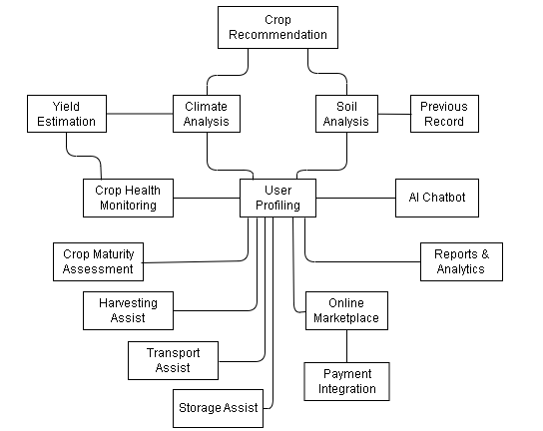
Box & Line Diagram

Slide 7
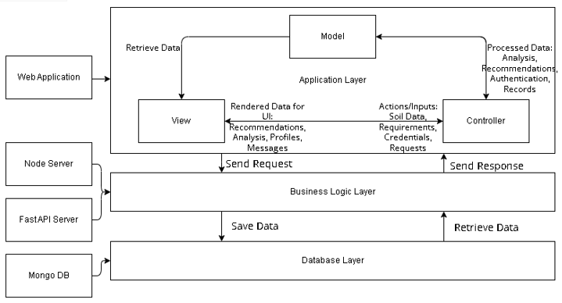
Architectural Diagram

Slide 8


